Slide 1

JSON Web Token
Dima Ionut Daniel

Slide 2
Contents
What is JWT?
Terminology
Structure
Core
JWS
Conclusions
Bibliography

Slide 3

What is JWT ?
JSON Web Token (JWT) is an Internet standard for creating data with optional signature and/or optional encryption whose payload holds JSON that asserts some number of claims.
The tokens are signed either using a private secret or a public/private key.
JWT relies on other JSON-based standards: JSON Web Signature and JSON Web Encryption.
JWT is described in RFC 7519.

Slide 4
What is JWT ? (cont.)
The tokens can be signed by one party's private key (usually the server's) so that party can subsequently verify the token is legitimate. If the other party, by some suitable and trustworthy means, is in possession of the corresponding public key, they too can verify the token's legitimacy.
The tokens are designed to be compact, URL-safe, and usable especially in a web-browser single-sign-on (SSO) context.
JWT claims can typically be used to pass identity of authenticated users between an identity provider and a service provider, or any other type of claims as required by business processes.

Slide 5
Terminology
JWT(JWT Web Token) is a string representing a set of claims as a JSON object that is encoded in a JWS or JWE.
JET Claims Set is a JSON object that contains the claims conveyed by the JWT.
Claim is a piece of information asserted about a subject
Claim Name is the name portion of a claim representation, it's always a string.
Claim Value is the value portion of a claim representation and can be a JSON value.

Slide 6
Terminology (cont.)
JWS (JSON Web Signature) is a data representing a digitally signed or MACed message.
JOSE Header(JSON Object Signing and Encryption) is a header comprised of a set of Header parameters.
JWS Payload represents a sequence of octets that is secured.
JWS Signature represents the digital signaure or MAC over the JWS protected header and the JWS payload.

Slide 7
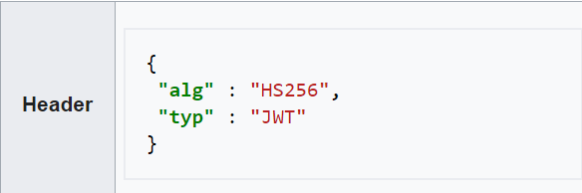
Structure
Header
Identifies which algorithm is used to generate the signature
HS256 indicates that this token is signed using HMAC-SHA256.
Typical cryptographic algorithms used are HMAC with SHA-256 (HS256) and RSA signature with SHA-256 (RS256).
JWA (JSON Web Algorithms) RFC 7518 introduces many more for both authentication and encryption.

Slide 8
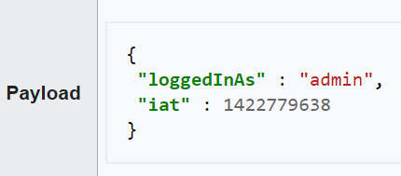
Structure (cont.)
Payload
It contains a set of claims.
The JWT specification defines seven Registered Claim Names which are the standard fields commonly included in tokens.
Custom claims are usually also included, depending on the purpose of the token.

Slide 9
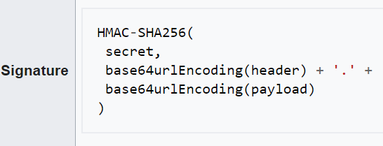
Structure (cont.)
Signature
It validates the token.
The signature is calculated by encoding the header and payload using Base64url Encoding and concatenating the two together with a period separator.
That string is then run through the cryptographic algorithm specified in the header, in this case HMAC-SHA256. The Base64url Encoding is like base64 but uses different non-alphanumeric characters and omits padding.

Slide 10
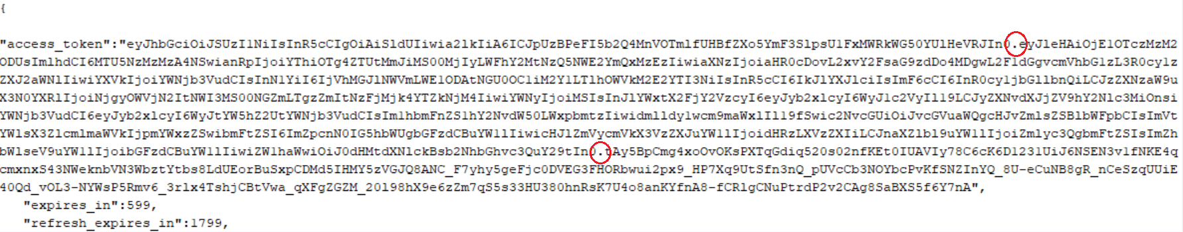
Structure (cont.)
The three parts are encoded separately using Base64url Encoding and concatenated using periods to produce the JWT.
token = base64urlEncoding(header) + '.' + base64urlEncoding(payload) + '.' + base64urlEncoding(signature)

Slide 11
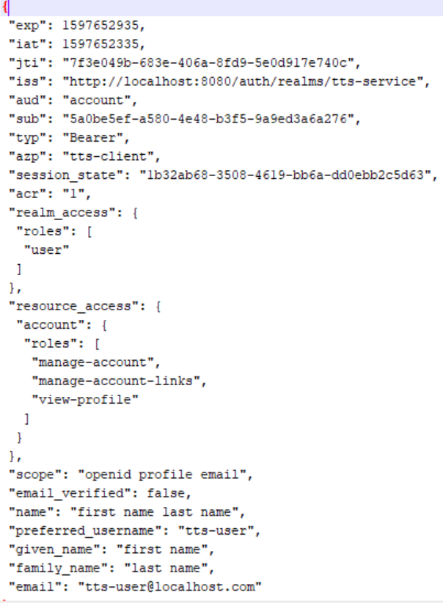
Structure (cont.)

Slide 12
Core
In authentication, when the user successfully logs in using their credentials, a JSON Web Token will be returned and must be saved locally, instead of the traditional approach of creating a session in the server and returning a cookie.
Whenever the user wants to access a protected route or resource, the user agent should send the JWT, typically in the Authorization header using the Bearer schema.
Authorization: Bearer ${token}

Slide 13
Core (cont.)
This is a stateless authentication mechanism as the user state is never saved in server memory.
The server's protected routes will check for a valid JWT in the Authorization header, and if it is present, the user will be allowed to access protected resources

Slide 14
Core (cont.)
The internet drafts define the following standard fields ("claims") that can be used inside a JWT claim set
Code | Name | Description
iss | Issuer | Identifies principal that issued the JWT
sub | Subject | Identifies the subject of the JWT
aud | Audience | Identifies the recipients that the JWT is intended for
exp | Expiration Time | Identifies the expiration time on and after which the JWT must not be accepted for processing. The value must be a NumericDate.
nbf | Not Before | Identifies the time on which the JWT will start to be accepted for processing. The value must be a NumericDate
iat | Issued at | Identifies the time at which the JWT was issued. The value must be a NumericDate.
jti | JWT ID | Case sensitive unique identifier of the token even among different issuers

Slide 15
Core (cont.)
The following fields can be used in authentication headers
Code | Name | Description
typ | Token type | If present, it is recommended to set this to JWT
cty | Content type | If nested signing or encryption is employed, it is recommended to set this to JWT; otherwise, omit this field
alg | Message authentication code algorithm | The issuer can freely set an algorithm to verify the signature on the token. However, some supported algorithms are insecure

Slide 16
Core (cont.)
The "sub" (subject) claim identifies the principal is the subject of the JWT.
The claims in a JWT are normally statements about the subject.
The "sub" value is a case-sensitive string containing a StringOrURI value.
Use of this claim is OPTIONAL.

Slide 17
Core (cont.)
The "aud" (audience) claim identifies the recipients that the JWT is intended for.
If the principal processing the claim does not identify itself with a value in the "aud" claim when this claim is present, then the JWT MUST be rejected.
The "aud" value is an array of case-sensitive strings, each containing a StringOrURI value.

Slide 18
Core (cont.)
The "exp" (expiration time) claim identifies the expiration time.
The processing of the "exp" claim requires that the current date/time MUST be before the expiration date/time listed in the "exp" claim.
Use of this claim is OPTIONAL.

Slide 19
Core (cont.)
The "nbf" (not before) claim identifies the time before which the JWT MUST NOT be accepted for processing.
The processing of the "nbf" claim requires that the current date/time MUST be after or equal to the not-before date/time listed in the "nbf" claim.
Use of this claim is OPTIONAL.

Slide 20
Core (cont.)
The "iat" (issued at) claim identifies the time at which the JWT was issued.
This claim can be used to determine the age of the JWT.
Its value MUST be a number containing a NumericDate value.
Use of this claim is OPTIONAL.

Slide 21
Core (cont.)
The "jti" (JWT ID) claim provides a unique identifier for the JWT.
The "jti" value is a case-sensitive string.
Use of this claim is OPTIONAL.

Slide 22
Core (cont.)
The "typ" (type) Header Parameter defined by JWS and JWE is used by JWT applications to declare the media type of the complete JWT.
This is intended for use by the JWT application when values that are not JWTs could also be present in an application data structure that can contain a JWT object.
Use of this Header Parameter is OPTIONAL.

Slide 23
Core (cont.)
The "cty" (content type) Header Parameter defined by JWS and JWE is used by this specification to convey structural information about the JWT.
In the normal case in which nested signing or encryption operations are not employed, the use of this Header Parameter is NOT RECOMMENDED.
In the case that nested signing or encryption is employed, this Header Parameter MUST be present.

Slide 24
JWS
JWS(JSON Web Signature) represents digitally signed or MACed content using JSON data structure and base64url encoding.
A JWS represents these logical values:
JOSE Header
JWS Payload
JWS Signature

Slide 25
JWS (cont.)
The JOSE Header members are the union of the members of these values:
JWS Protected Header
JWS Unprotected Header

Slide 26
JWS (cont.)
The "jku" (JWK Set URL) Header Parameter is a URI that refers to a resource for a set of JSON-encoded public keys, one of which corresponds to the key used to digitally sign the JWS.
The keys MUST be encoded as a JWK Set.
The protocol used to acquire the resource MUST provide integrity protection.

Slide 27
JWS (cont.)
The "jwk" (JSON Web Key) Header Parameter is the public key that corresponds to the key used to digitally sign the JWS.
This key is represented as a JWK(JSON Web Key).
Use of this Header Parameter is OPTIONAL.

Slide 28
JWS (cont.)
The "kid" (key ID) Header Parameter is a hint indicating which key was used to secure the JWS.
This parameter allows originators to explicitly signal a change of key to recipients.
The structure of the "kid" value is unspecified.
Its value MUST be a case-sensitive string.
Use of this Header Parameter is OPTIONAL.

Slide 29
JWS (cont.)
The "x5u" (X.509 URL) Header Parameter is a URI that refers to a resource for the X.509 public key certificate or certificate chain corresponding to the key used to digitally sign the JWS.
Use of this Header Parameter is OPTIONAL.

Slide 30
JWS (cont.)
The "x5c" (X.509 certificate chain) Header Parameter contains the X.509 public key certificate or certificate chain corresponding to the key used to digitally sign the JWS.
The certificate or certificate chain is represented as a JSON array of certificate value strings.
Use of this Header Parameter is OPTIONAL.

Slide 31
Conclusions
JWTs expire at specific intervals
JWTs are signed
JWTs have exploits
JWTs aren't easily revocable

Slide 32

Bibliography
https://tools.ietf.org/html/rfc7519
https://tools.ietf.org/html/rfc7515
https://en.wikipedia.org/wiki/JSON_Web_Token

